Slide 1
Nearby Travel Destinations for New Yorkers during COVID-19
Charles shin, Xinyi Zhang, LJ Zhang, Mubai Liu, Wen Yin

Slide 2
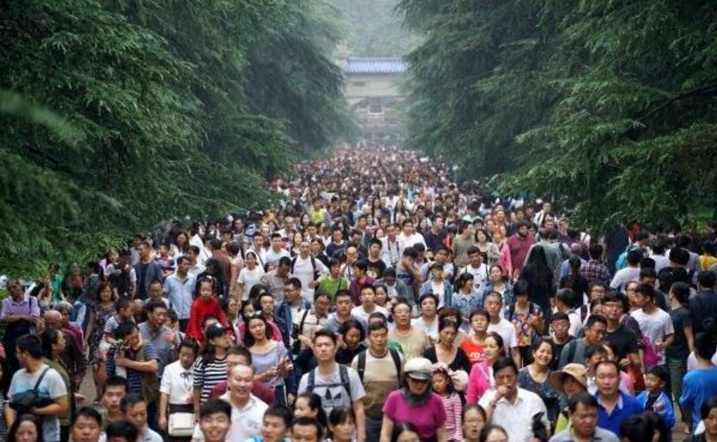
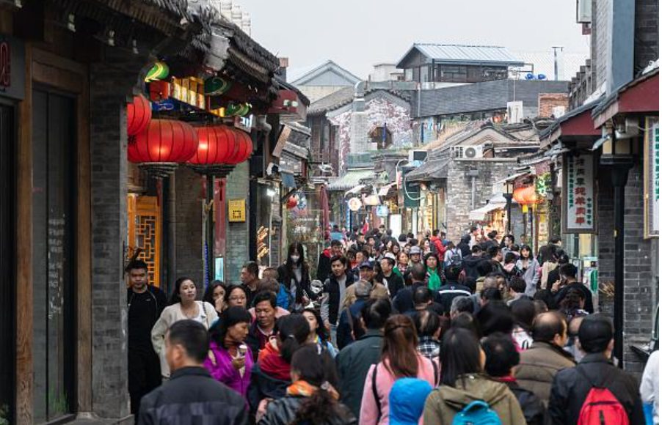
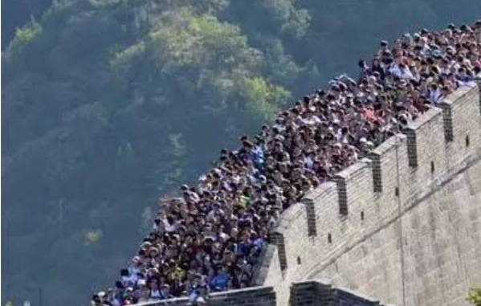
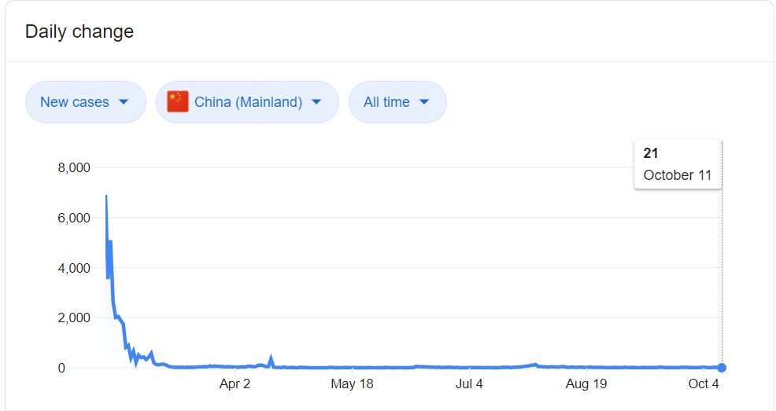
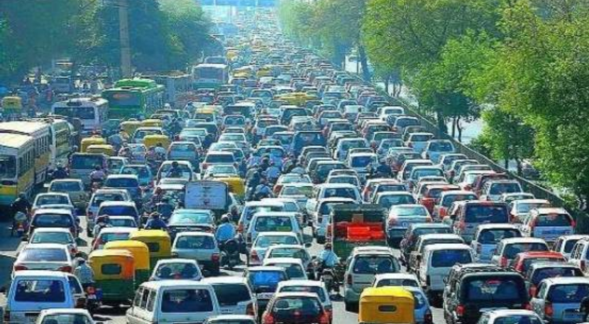
Chinese tourist sites packed during “Golden Week” holiday as country comes out of lockdown
Data shows that the busy holiday vacation did generate $ 66 billion tourism revenues without bringing a “second wind” of COVID-19 infection (JHU CSSE)

Slide 3
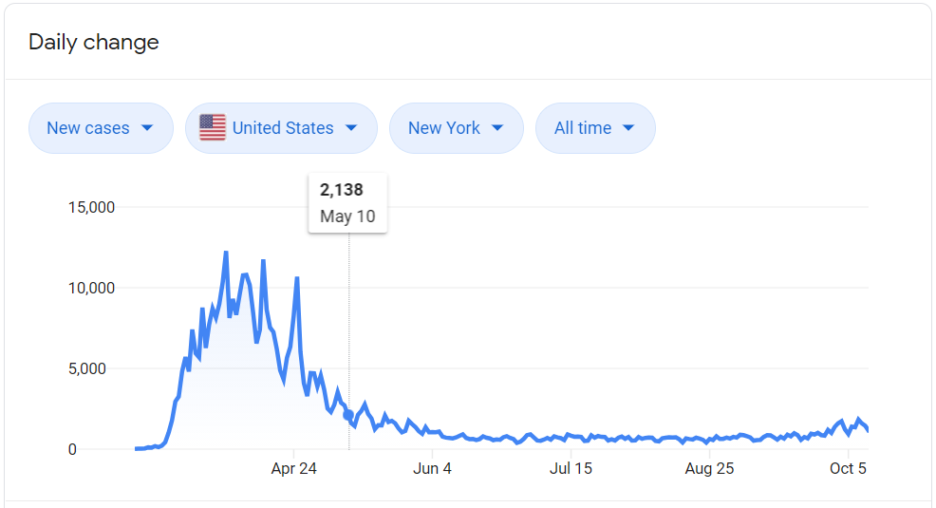
Today’s China will be Tomorrow’s America (regarding COVID-19)
With flat curve of new confirmed cases during recent three months, New York City has entered Phase 4 of reopening, which includes Higher Education, Gyms and Fitness, Indoor dinning of restaurants.
“ No dark cloud can forever prevent the sun from shining ! ” ----- Mehmet Murat
Halloween, Thanksgiving and Christmas are all around the corner. After half a year quarantine, where can New Yorkers go to enjoy a vacation?

Slide 4
Someone may jump out to argue….
Wait, even the curve for new confirmed cases are flat for three months, there are still not “absolute zero”
34,000 US citizen died because of Flu in 2019, and 61,000 died in 2018 for the same reason (CDC). However, Flu is there for decades and American keeps traveling.
A meaningful and enjoyable life suppose to be somehow “risky” : No drink, No sport, No vacation, No hangout, No dating, No marriage. May be safe, but could be boring.
We believe that there is a better alternative to that “risk free & boring strategy”. Our Mission today is to help New Yorkers figure out potential “high return, low risk” travelling options.

